Slide 1
Designing System Architecture

Slide 2
The Design Process
Design is the creative process of figuring out how to implement all of the customer’s requirements; the resulting plan is also called the design
Early design decisions address the system’s architecture
Later design decisions address how to implement the individual units

Slide 3
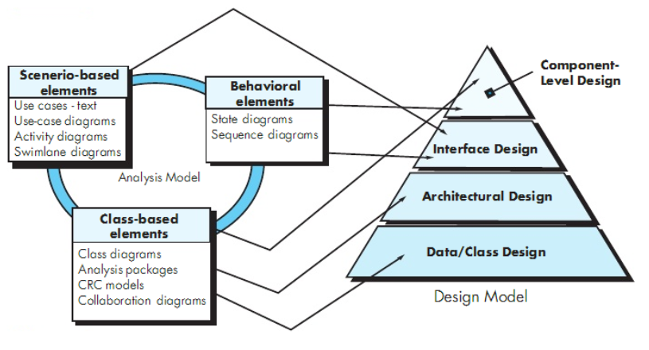
Translating Requirements to Design

Slide 4
Design or Requirements?
A room for three children to play and a separate place for them to sleep
A room for Father and Mother to sleep
A room for cooking
Heating for the winter and cooling for the summer
Indoor water and electricity

Slide 5
Multiple Designs?
Maximize playing area
Minimize playing area
Large bedrooms
Two storey house
Single storey house
Which is the best design?
Will a proposed solution result in modified requirements?

Slide 6
5.1 The Design Process Design is a Creative Process
Design is an intellectually challenging task
Numerous possibilities the system must accommodate
Nonfunctional design goals (e.g., ease of use, ease to maintain)
External factors (e.g., standard data formats, government regulations)
We can improve our design by studying examples of good design
Most design work is routine design, solve problem by reusing and adapting solutions from similar problems

Slide 7
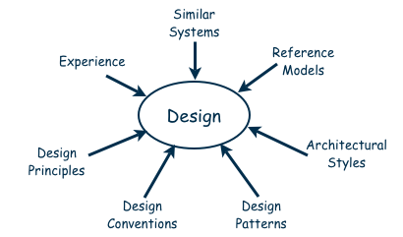
5.1 The Design Process Design is a Creative Process (continued)
Many ways to leverage existing solutions
Cloning: Borrow design/code in its entirety, with minor adjustments
Reference models: Generic architecture that suggests how to decompose the system

Slide 8
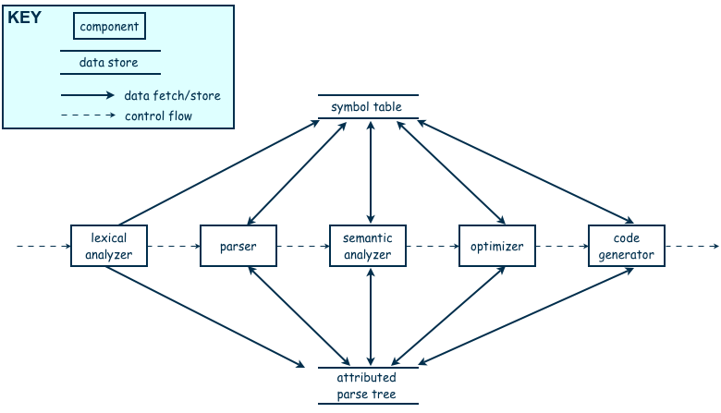
5.1 The Design Process Design is a Creative Process (continued)
Reference model for a compiler

Slide 9
5.1 The Design Process Design is a Creative Process (continued)
More typically, a reference model will not exist for the problem
Software architectures have generic solutions too, referred to as architectural styles
Focusing on one architectural style can create problems
Good design is about selecting, adapting, and integrating several architectural design styles to produce the desired result

Slide 10
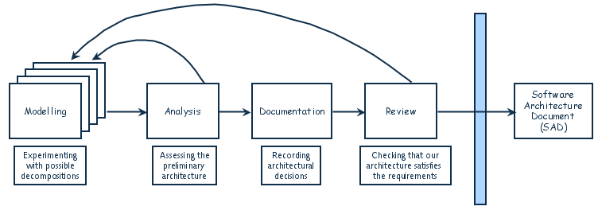
5.1 The Design Process Design is an Iterative Process (continued)
The designers move back and forth among activities involving:
Understanding requirements, proposing solutions, testing feasibility of a solution, presenting possibilities to the customers, documenting the design for programmers
The final outcome is the software architecture document (SAD)

Slide 11
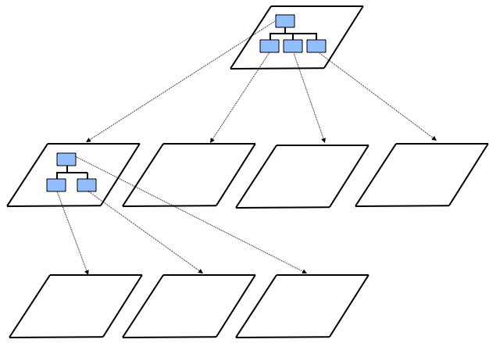
5.3 Decomposition and Views
High-level description of system’s key elements
Creating a hierarchy of information with increasing details
Top
level
First level of
decomposition
Second level of
decomposition

Slide 12
5.3 Decomposition and Views Popular Design Methods
Some design problems have no existing solutions
Designers must decompose to isolate key problems
Some popular design methods:
Functional decomposition
Feature-oriented decomposition
Data-oriented decomposition
Event-oriented decomposition
Object-oriented design

Slide 13
5.3 Decomposition and Views Popular Design Methods
Functional decomposition
partitions functions or requirements into modules
begins with the functions that are listed in the requirements specification
lower-level designs divide these functions into subfunctions, which are then assigned to smaller modules
describes which modules (subfunctions) call each other

Slide 14
Functional Decomposition Example
Student Registration System
Data Entry Validation
Transaction Verification
Report Generation
Data Updation
Student Data Validation
Course Data Validation
Transaction Checks
Addition Modules
Deletion Module

Slide 15
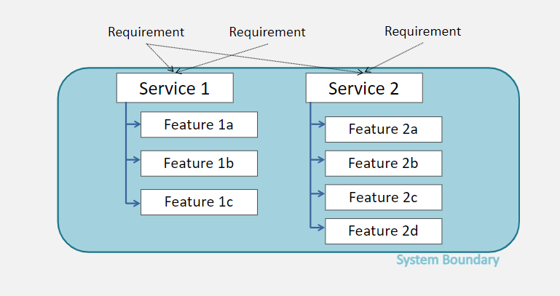
Feature Oriented Decomposition Example

Slide 16
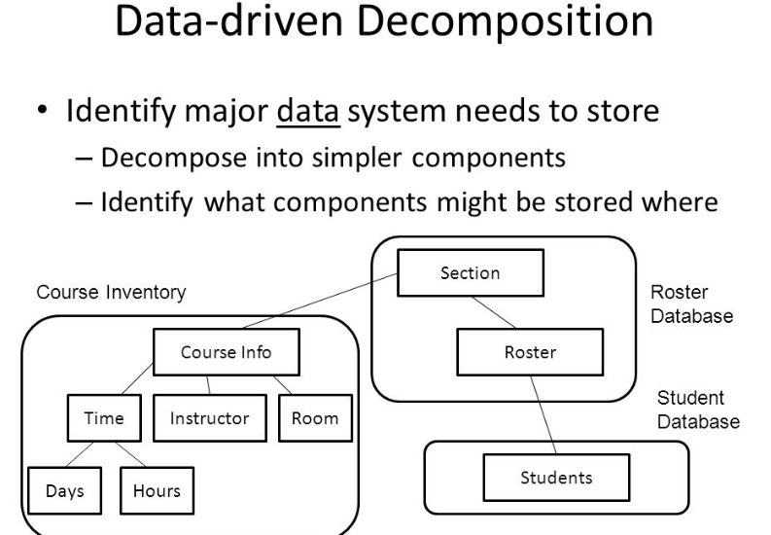
Data Driven Decomposition Example

Slide 17
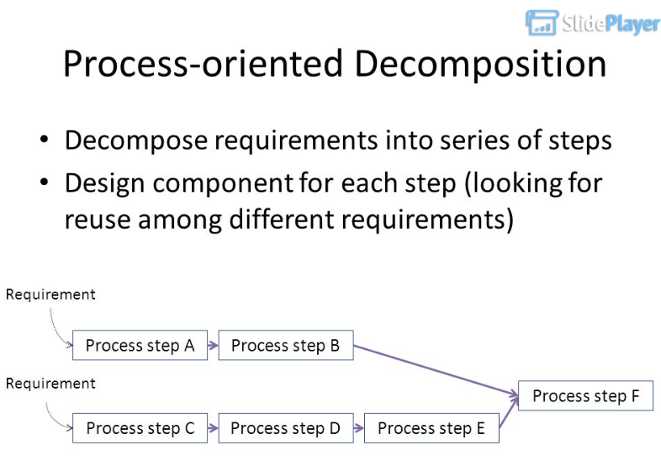
Process –oriented Decomposition Example

Slide 18
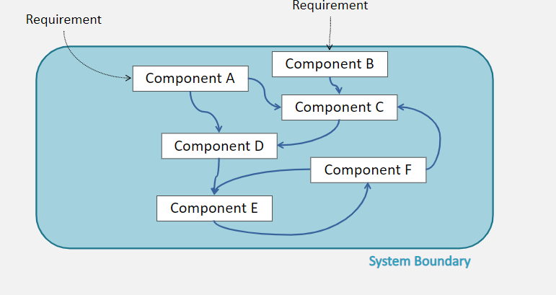
Event –oriented Decomposition Example

Slide 19
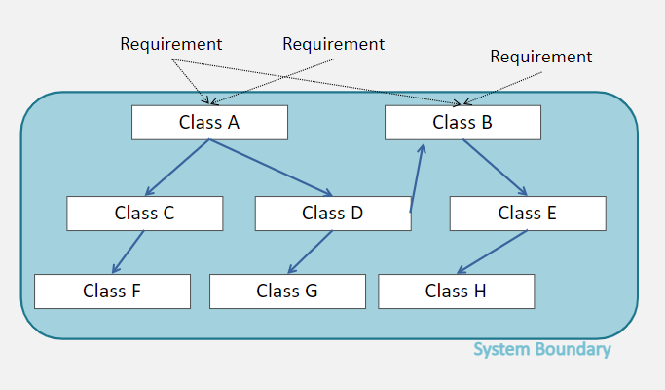
Object –oriented Decomposition Example

Slide 20
5.3 Decomposition and Views Popular Design Methods (continued)
A design is modular when each activity of the system is performed by exactly one software unit, and when the inputs and outputs of each software unit are well-defined

Slide 21
5.3 Decomposition and Views Sidebar 5.2 Component-based Software Engineering
Component-based software engineering (CBSE) is a method of software development whereby systems are created by assembling together preexisting components
A component is “a self-contained piece of software with a well-defined set of interfaces” that can be developed, bought, and sold as a distinct entity
The goal of CBSE is to support the rapid development of new systems, by reducing development to component integration, and to ease the maintenance of such systems by reducing maintenance to component replacement
At this point, CBSE is still more of a goal than a reality with considerable on-going research

Slide 22
5.4 Architectural Styles and Strategies
Pipe-and-Filter
Client-Server
Peer-to-Peer
Publish-Subscribe
Repositories
Layering

Slide 23
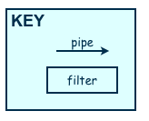
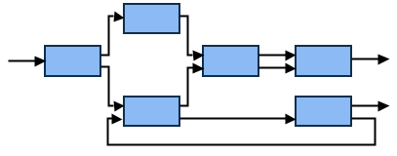
5.4 Architectural Styles and Strategies Pipe-and-Filter
The system has
Streams of data (pipe) for input and output
Transformation of the data (filter)
KEY
pipe

Slide 24
5.4 Architectural Styles and Strategies Pipe-and-Filter (continued)
Several important properties
The designer can understand the entire system's effect on input and output as the composition of the filters
The filters can be reused easily on other systems
System evolution is simple
Allow concurrent execution of filters
Drawbacks
Not good for handling interactive application

Slide 25
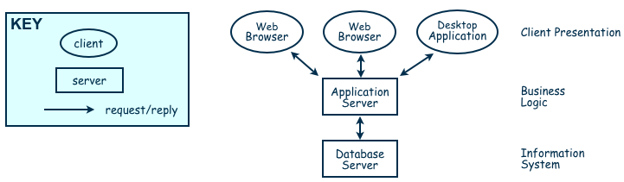
5.4 Architectural Styles and Strategies Client-Server
Two types of components:
Server components offer services
Clients access them using a request/reply protocol
Client may send the server an executable function, called a callback
The server subsequently calls under specific circumstances

Slide 26
5.4 Architectural Styles and Strategies Peer-to-Peer (P2P)
Each component acts as its own process and acts as both a client and a server to other peer components.
Any component can initiate a request to any other peer component.
Characteristics
Scale up well
Increased system capabilities
Highly tolerant of failures
Examples: Napster, Kaaza, BitTorrent

Slide 27
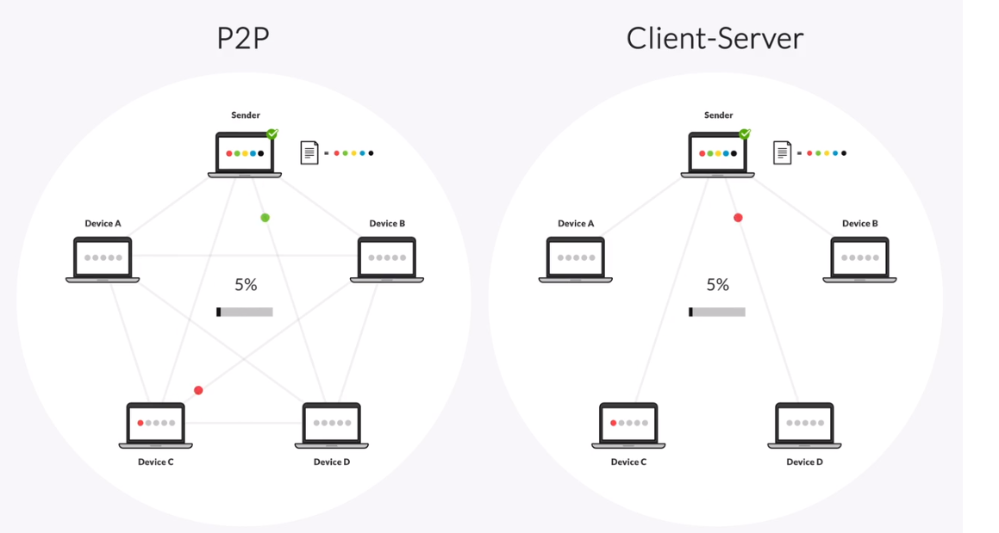
5.4 Architectural Styles and Strategies

Slide 28
5.4 Architectural Styles and Strategies Peer-to-Peer (P2P)
When NOT to use:
When file contents change frequently (e.g. prices)
When sharing speed has importance (e.g. large files are needed quickly)
File quality is critical
When trust between peers is required (e.g. the content is protected)

Slide 29
5.4 Architectural Styles and Strategies Publish-Subscribe
interact by broadcasting and reacting to events Components
Component expresses interest in an event by subscribing to it
When another component announces (publishes) that event has taken place, subscribing components are notified
Implicit invocation is a common form of publish-subscribe architecture
Registering: subscribing component associates one of its procedures with each event of interest (called the procedure)
Characteristics
Strong support for evolution and customization
Easy to reuse components in other event-driven systems
Need shared repository for components to share persistent data
Difficult to test

Slide 30
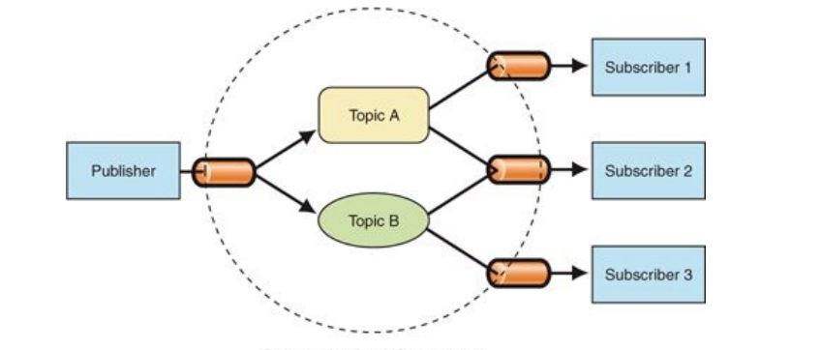
5.4 Architectural Styles and Strategies Publish-Subscribe

Slide 31
5.4 Architectural Styles and Strategies Repositories
Two components
A central data store
A collection of components that operate on it to store, retrieve, and update information (data accessors)
The challenge is deciding how the components will interact
A traditional database: transactions trigger process execution
A blackboard: the central store controls the triggering process
Knowledge sources: information about the current state of the system’s execution that triggers the execution of individual data accessors

Slide 32
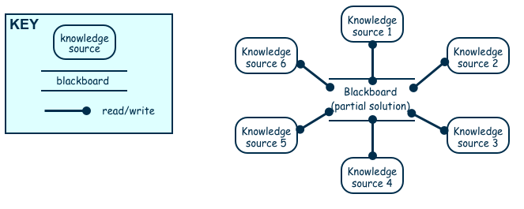
5.4 Architectural Styles and Strategies Repositories (continued)
Openness?
Data representation is made available to various programmers (vendors) so they can build tools to access the repository
But also a disadvantage: the data format must be acceptable to all components

Slide 33
5.4 Architectural Styles and Strategies Layering
Layers are hierarchical
Each layer provides service to the one outside it and acts as a client to the layer inside it
Layer bridging: allowing a layer to access the services of layers below its lower neighbor
The design includes protocols
Explain how each pair of layers will interact
Advantages
High levels of abstraction
Relatively easy to add and modify a layer
Disadvantages
Not always easy to structure system layers
System performance may suffer from the extra coordination among layers

Slide 34
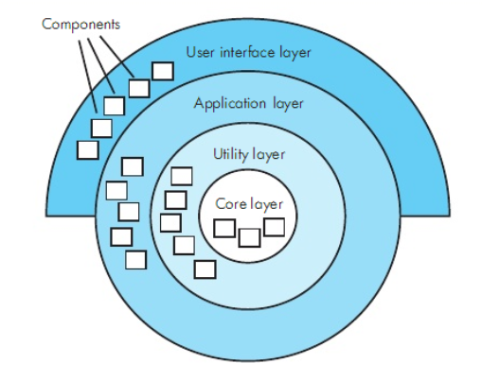
5.4 Architectural Styles and Strategies Example of Layering System

Slide 35
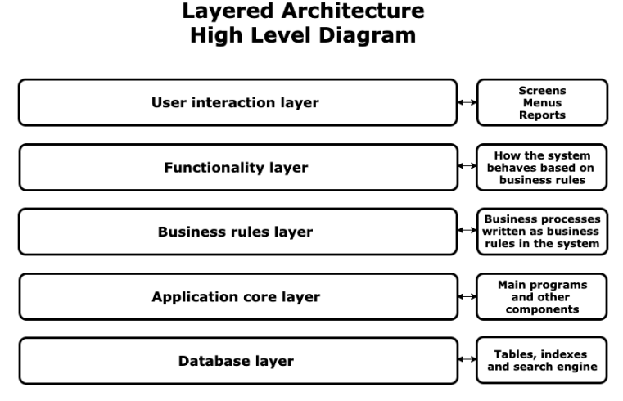
5.4 Architectural Styles and Strategies

Slide 36
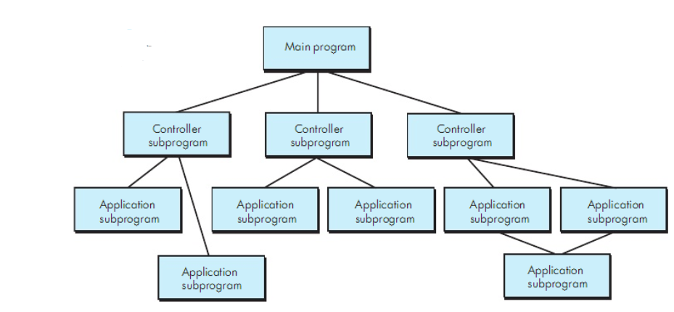
Architecture Styles and Strategies Call and Return
Main program/sub program
Easy to scale and modify

Slide 37
5.4 Architectural Styles and Strategies Combining Architectural Styles
Actual software architectures rarely based on purely one style
Architectural styles can be combined in several ways
Use different styles at different layers (e.g., overall client-server architecture with server component decomposed into layers)
Use mixture of styles to model different components or types of interaction (e.g., client components interact with one another using publish-subscribe communications
If architecture is expressed as collection of models, documentation must be created to show relation between models

Slide 38
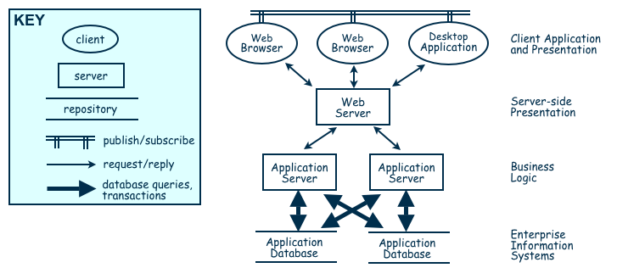
Architectural Styles and Strategies Combination of WHICH Architecture Styles?
Combination of Publish-Subscribe, Client-Server, Layering, Repository

Slide 39
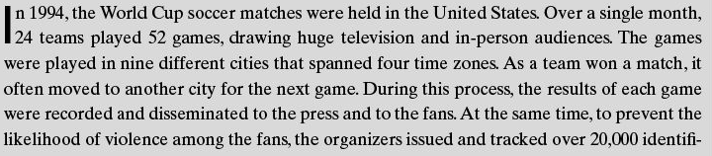
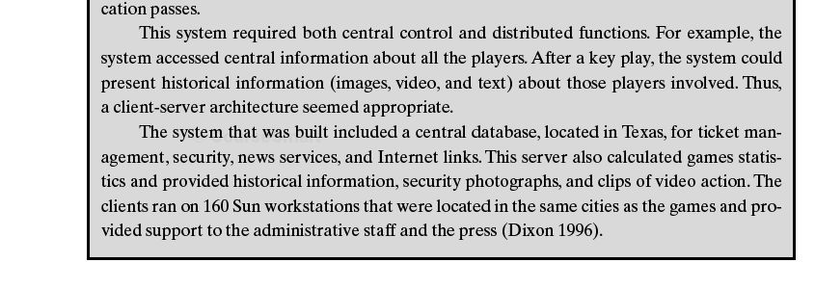
Architectural Styles and Strategies The World Cup System
Which

Slide 40
5.4 Architectural Styles and Strategies Sidebar 5.3 The World Cup Client-Server System
Over one month in 1994, the World Cup soccer matches were held in the United States. Design system issues:
24 teams played 52 games
nine different cities that spanned four time zones
results of each game were recorded and disseminated to the press and to the fans
To deter violence among the fans, the organizers issued and tracked over 20,000 identification passes
This system required both central control and distributed functions. Thus, a client-server architecture seemed appropriate.
The system that was built included a central database, located in Texas, for ticket management, security, news services, and Internet links. This server also calculated games statistics and provided historical information, security photographs, and clips of video action.
The clients ran on 160 Sun workstations that were located in the same cities as the games and provided support to the administrative staff and the press

Slide 41
Architecture Evaluation

Slide 42
Achieving Quality Attributes
Architectural styles provide general beneficial properties. Quality attributes also need to be supported:
Modifiability
Performance
Security
Reliability
Robustness
Usability
Business goals
Characteristics that users want to see in products that we build

Slide 43
Achieving Quality Attributes Modifiability
Design must be easy to change
Two classifications of affected software units:
Directly affected
Indirectly affected
Directly affected units’ responsibilities change to accommodate a system modification
Anticipate expected changes
Value cohesion
Maintain generality e,g servers
Indirectly affected units’ responsibilities do not change, but implementations must be revised
Lower coupling
Interact through interfaces
Employ multiple interfaces
Cost spent after first version?

Slide 44
Achieving Quality Attributes Performance
Performance attributes describe constraints on system speed and capacity:
Response time: How fast does our software respond to requests?
Throughput: How many requests can it process per minute?
Load: How many users can it support before response time and throughput start to suffer?

Slide 45
Achieving Quality Attributes Performance
Tactics for improving performance include:
Improve utilization of resources
Manage resource allocation more effectively
First-come/first-served: Requests are processed in the order in which they are received
Explicit priority: Requests are processed in order of their assigned priorities
Earliest deadline first: Requests are processed in order of their impending deadlines
Reduce demand for resources
Reduce computational overhead?
Increase resources? Multiple copies? Additional processors, memory? Lower sample rate?

Slide 46
Achieving Quality Attributes Security
Two key architectural characteristics particularly relevant to security: immunity and resilience
Immunity: ability to thwart an attempted attack
The architecture encourages immunity by:
Ensuring all security features are included in the design
Minimizing exploitable security weaknesses
Resilience: ability to recover quickly and easily from an attack
The architecture encourages resilience by:
Segmenting functionality to contain attack
Enabling the system to quickly restore functionality

Slide 47
Achieving Quality Attributes Reliability
A software system is reliable if it correctly performs its required functions under assumed conditions
Is the software internally free of errors?
A fault is the result of human error, compared to a failure, which is an observable departure from required behavior
Software is made more reliable by preventing or tolerating faults

Slide 48
Achieving Quality Attributes Reliability (continued)
Fault recovery: handling fault immediately to limit damage
Fault recovery tactics:
Undoing transactions: manage a series of actions as a single transaction that are easily undone if a fault occurs midway through the transaction
Checkpoint/rollback: software records a checkpoint of current state; rolls back to that point if system gets in trouble
Backup: system automatically substitutes faulty unit with backup
Degraded service: returns to previous state, offers degraded version of the service
Correct and continue: detects the problem and treats the symptoms
Report: system returns to its previous state and reports the problem to an exception-handling unit

Slide 49
Achieving Quality Attributes Robustness
A system is robust if it includes mechanisms for accommodating or recovering from problems in the environment or in other unit
Mutual suspicion: each software unit assumes that the other units contain faults
Robustness tactics differ from reliability tactics
Recovery tactics are similar:
Rollback to checkpoint state
Abort a transaction
Initiate a backup unit
Provide reduced service
Correct symptoms and continue processing
Trigger an exception

Slide 50
Achieving Quality Attributes Usability
Usability reflects the ease in which a user is able to operate the system
User interface should reside in its own software unit

Slide 51
Achieving Quality Attributes Business Goals
Business Goals are quality attributes the system is expected to exhibit (e.g., minimizing the cost of development and time to market)
Buy vs. Build
Save development time, money
More reliable
Existing components create constraints; vulnerable to supplier
Initial development vs. maintenance costs
Save money by making system modifiable
Increased complexity may delay release; lose market to competitors
New vs. known technologies
Acquiring expertise costs money, delays product release
Either learn how to use the new technology or hire new personnel
Eventually, we must develop the expertise ourselves

Slide 52
References
UCF slides for SE course (a few slides have been reused)
SE book by Pressman
SE book by Pfleeger
SE book by Ian Sommerville

